Slide 1
2014 Graduate Sunday
Evangelical Lutheran Church of Mt. Horeb

Slide 2
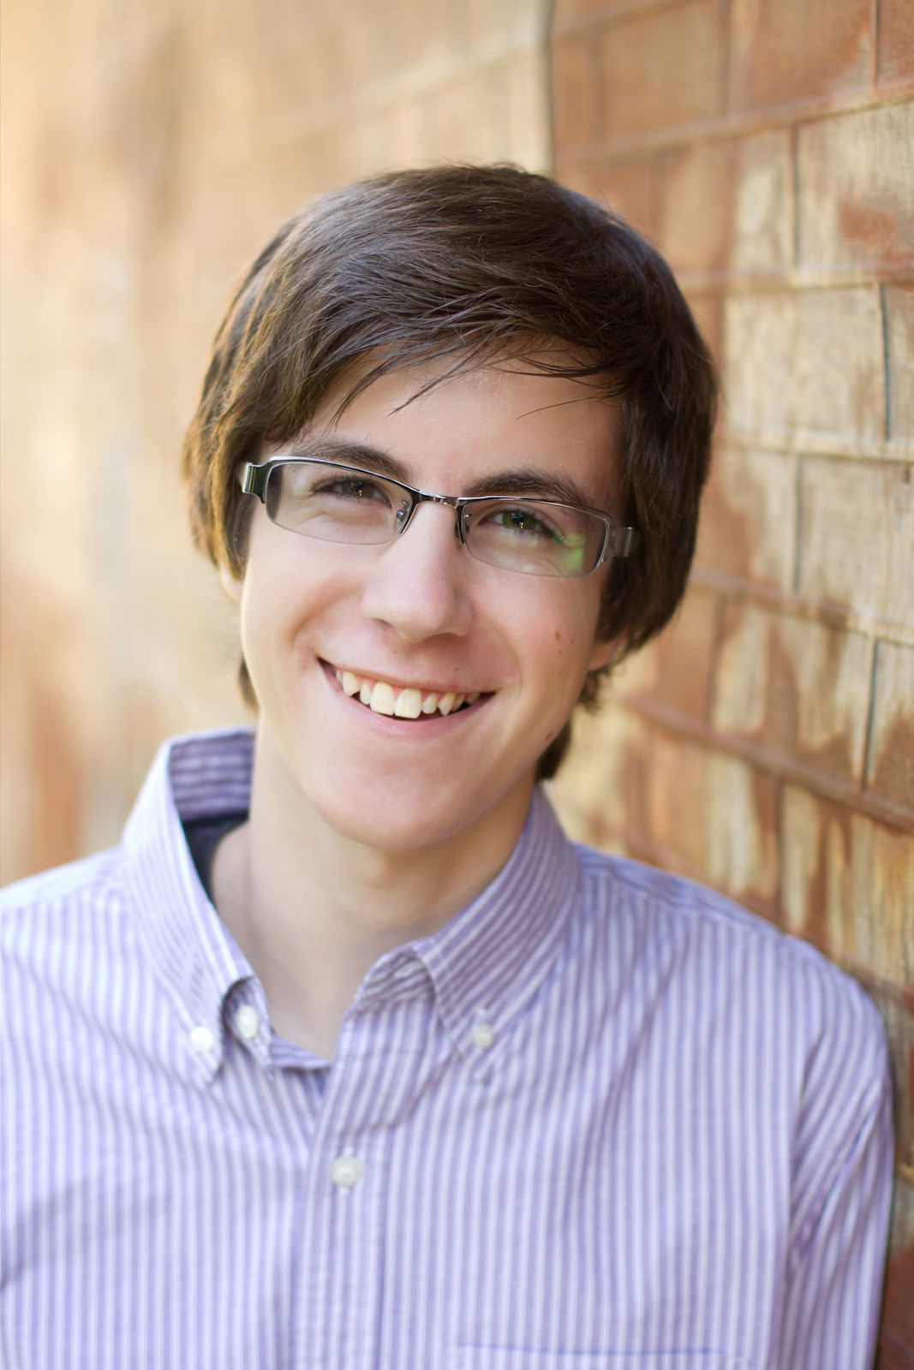
Charlie Laabs
Charlie plans to attend
UW-Platteville for Computer Engineering and Music

Slide 3
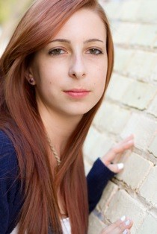
Makayla Jo Krueger
Makayla
will be attending the Cosmetology program at Madison Area Technical College

Slide 4
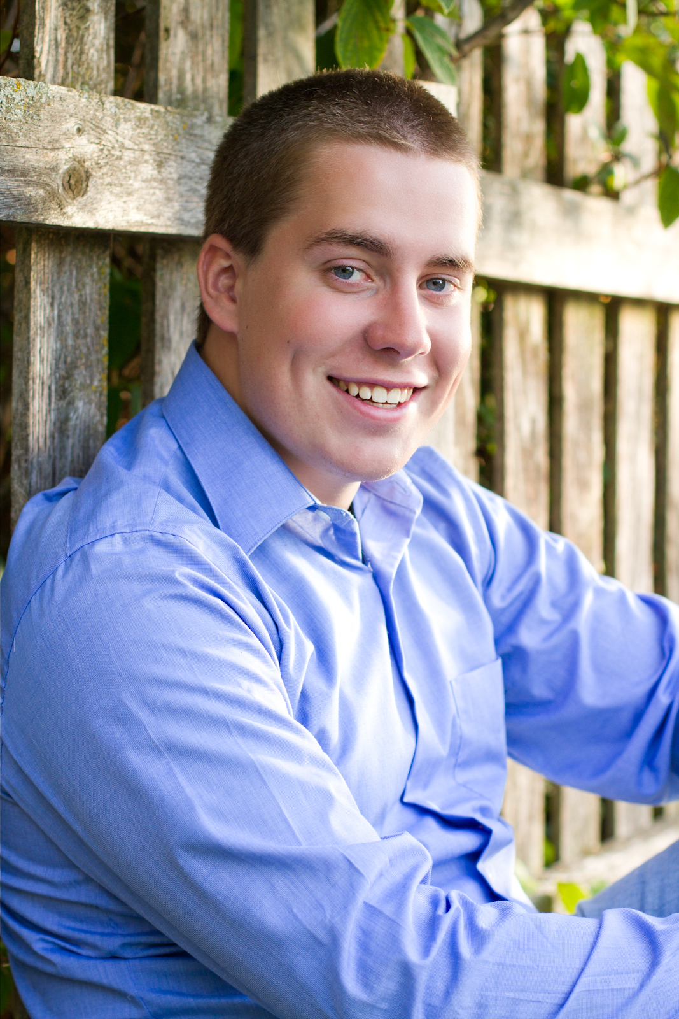
Michael Killian
Michael plans to attend UW Platteville in the fall with his major being unknown

Slide 5
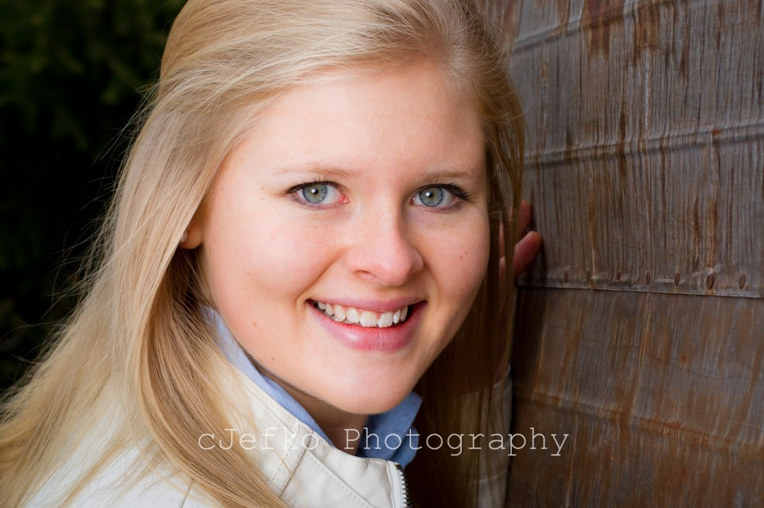
Abigail Nelson
Abbi will be attending Drake University with a double major in Music and Political Science.

Slide 6
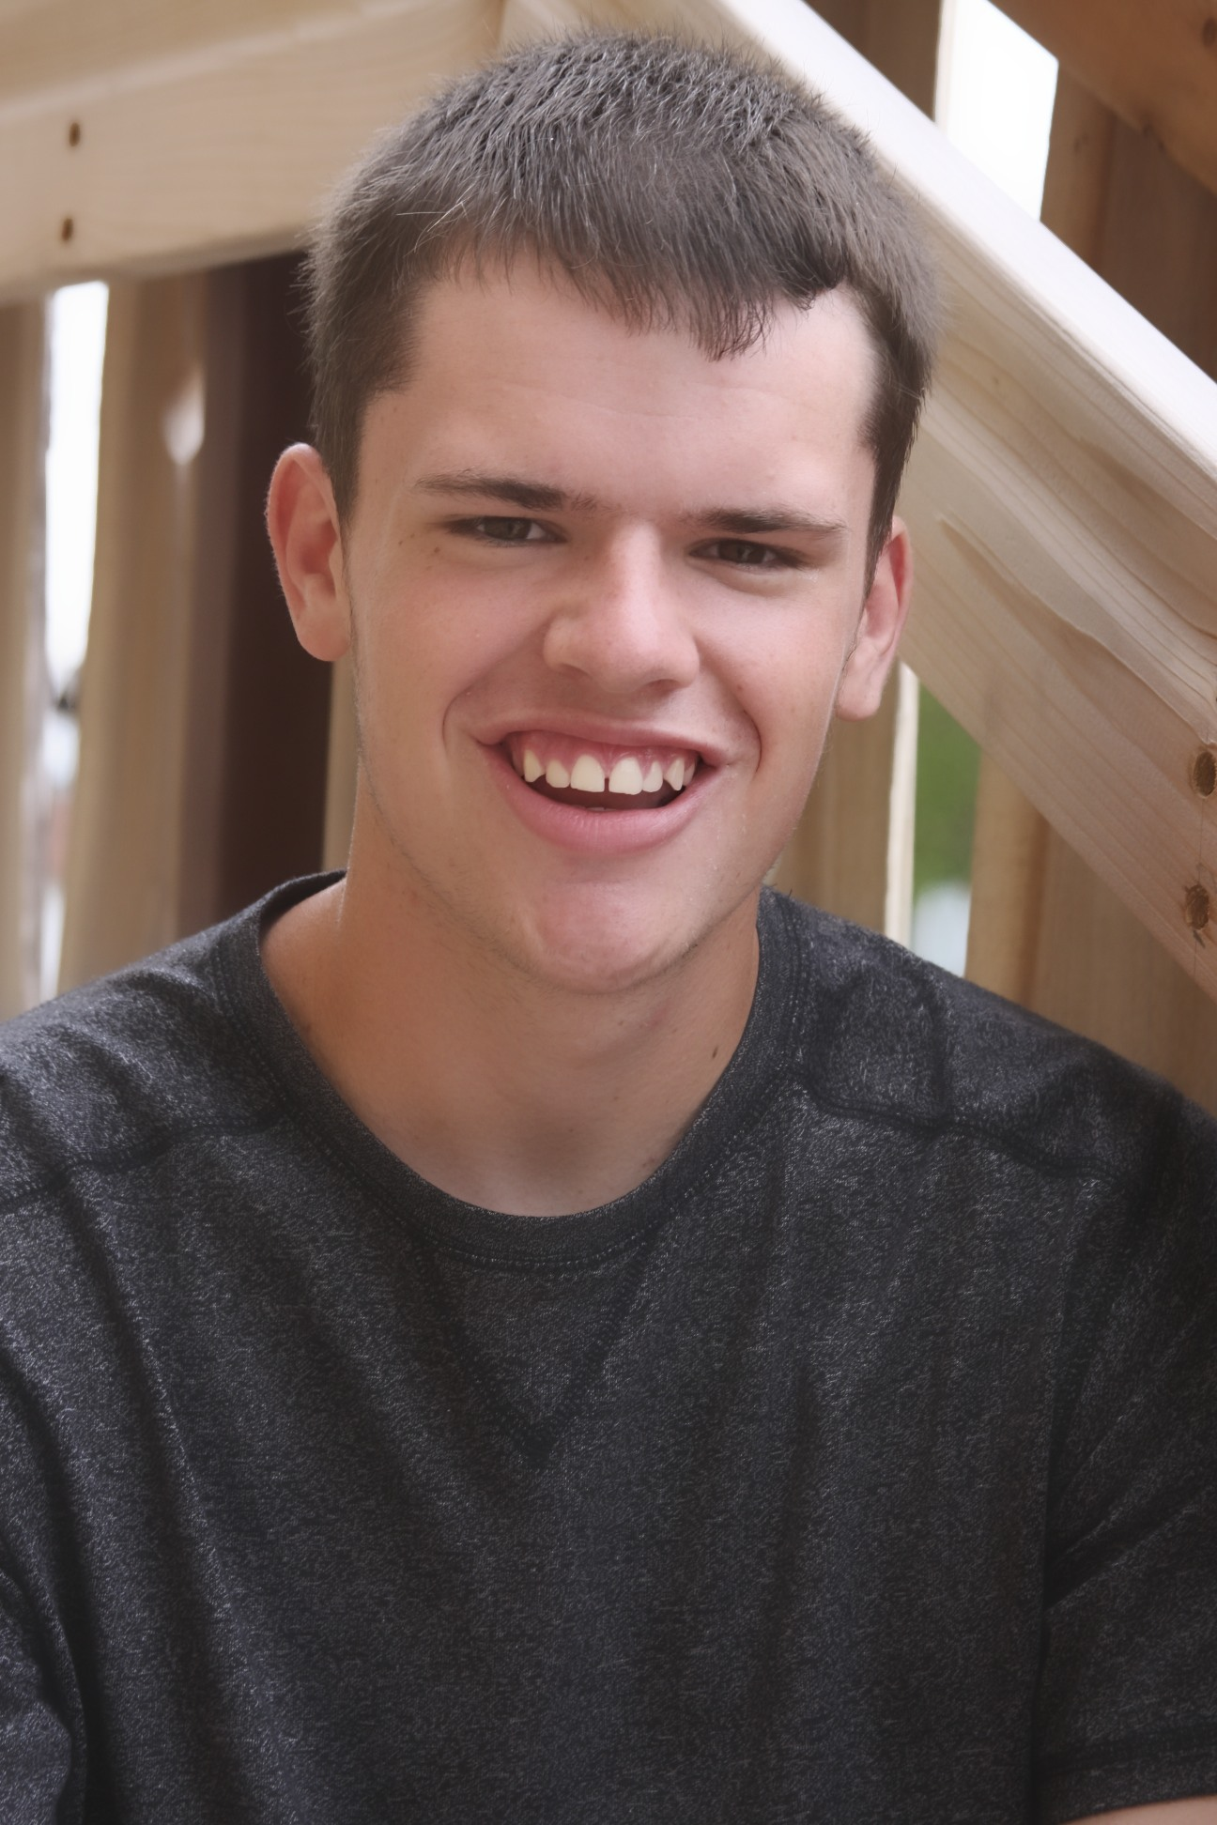
Geoffrey Krentz
Geoffrey will be attending University of Wisconsin - Whitewater to study business finance and economics.

Slide 7
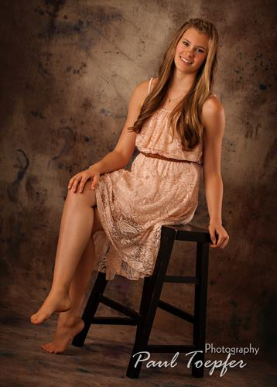
Kayla Witte
Kayla will be attending
Drake University
majoring in Elementary
Education with an
emphasis on reading,
unified special education,
and English as a second
language.

Slide 8
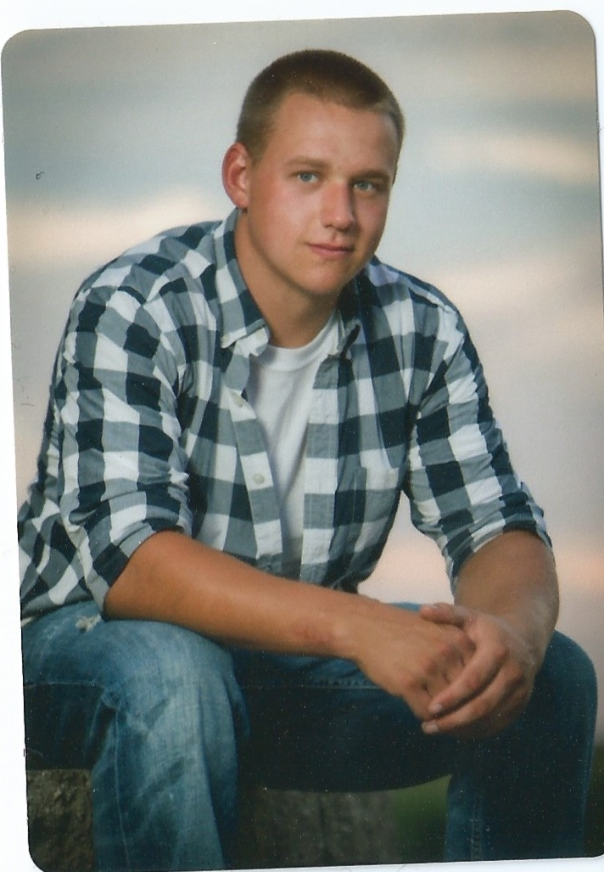
Ian Farrell
Ian will be attending MATC in the Business
Management Program

Slide 9
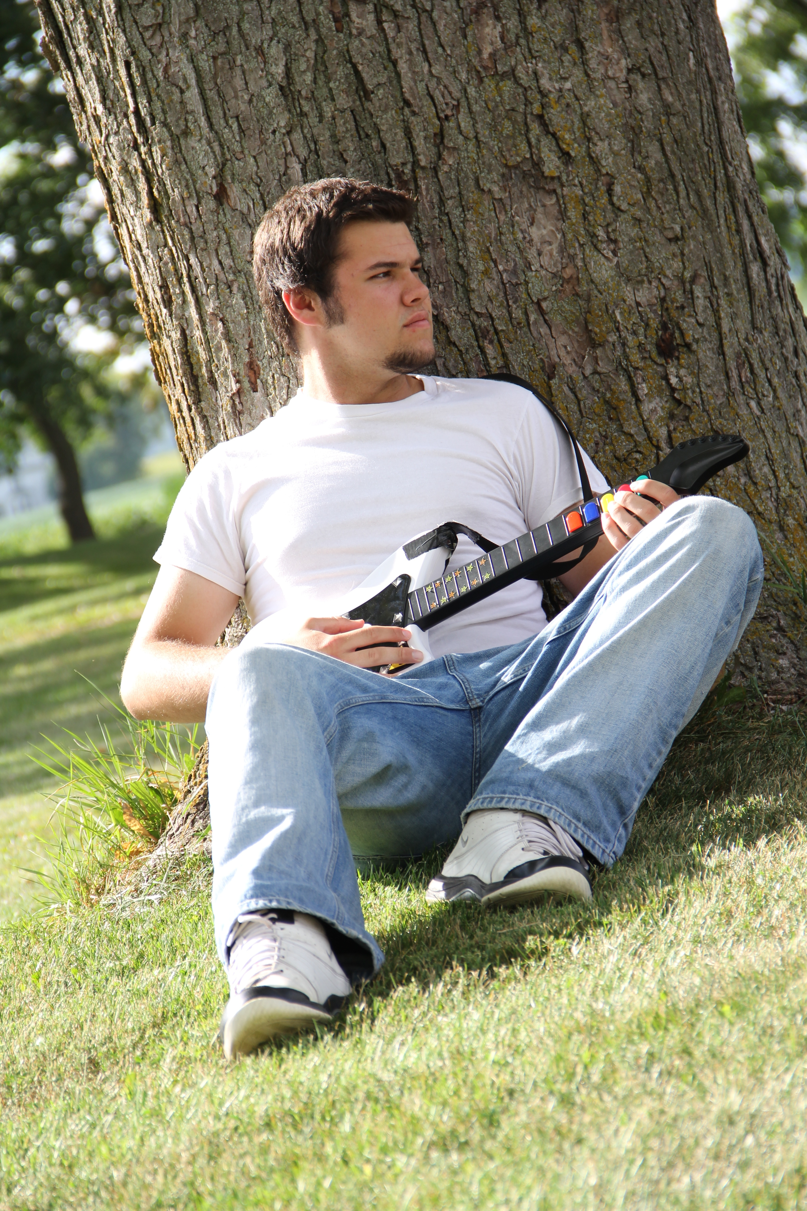
Alex Thompson
Alex will attend UW-Oshkosh where he will pursue a Bachelor of Arts Degree with a major in Journalism /Advertising and a minor in Radio-TV-Film.

Slide 10
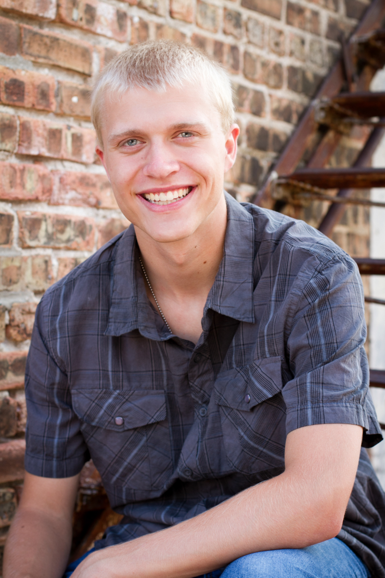
Lucas Schult
Lucas will attend UW Madison for Chemical Engineering

Slide 11
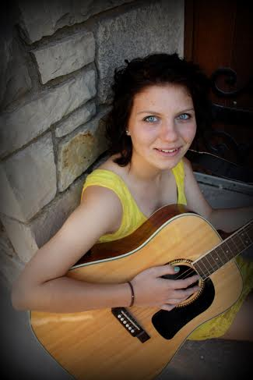
Brighid Monahan
Brighid Monahan will attend UW Platteville with a major in Horticulture

Slide 12
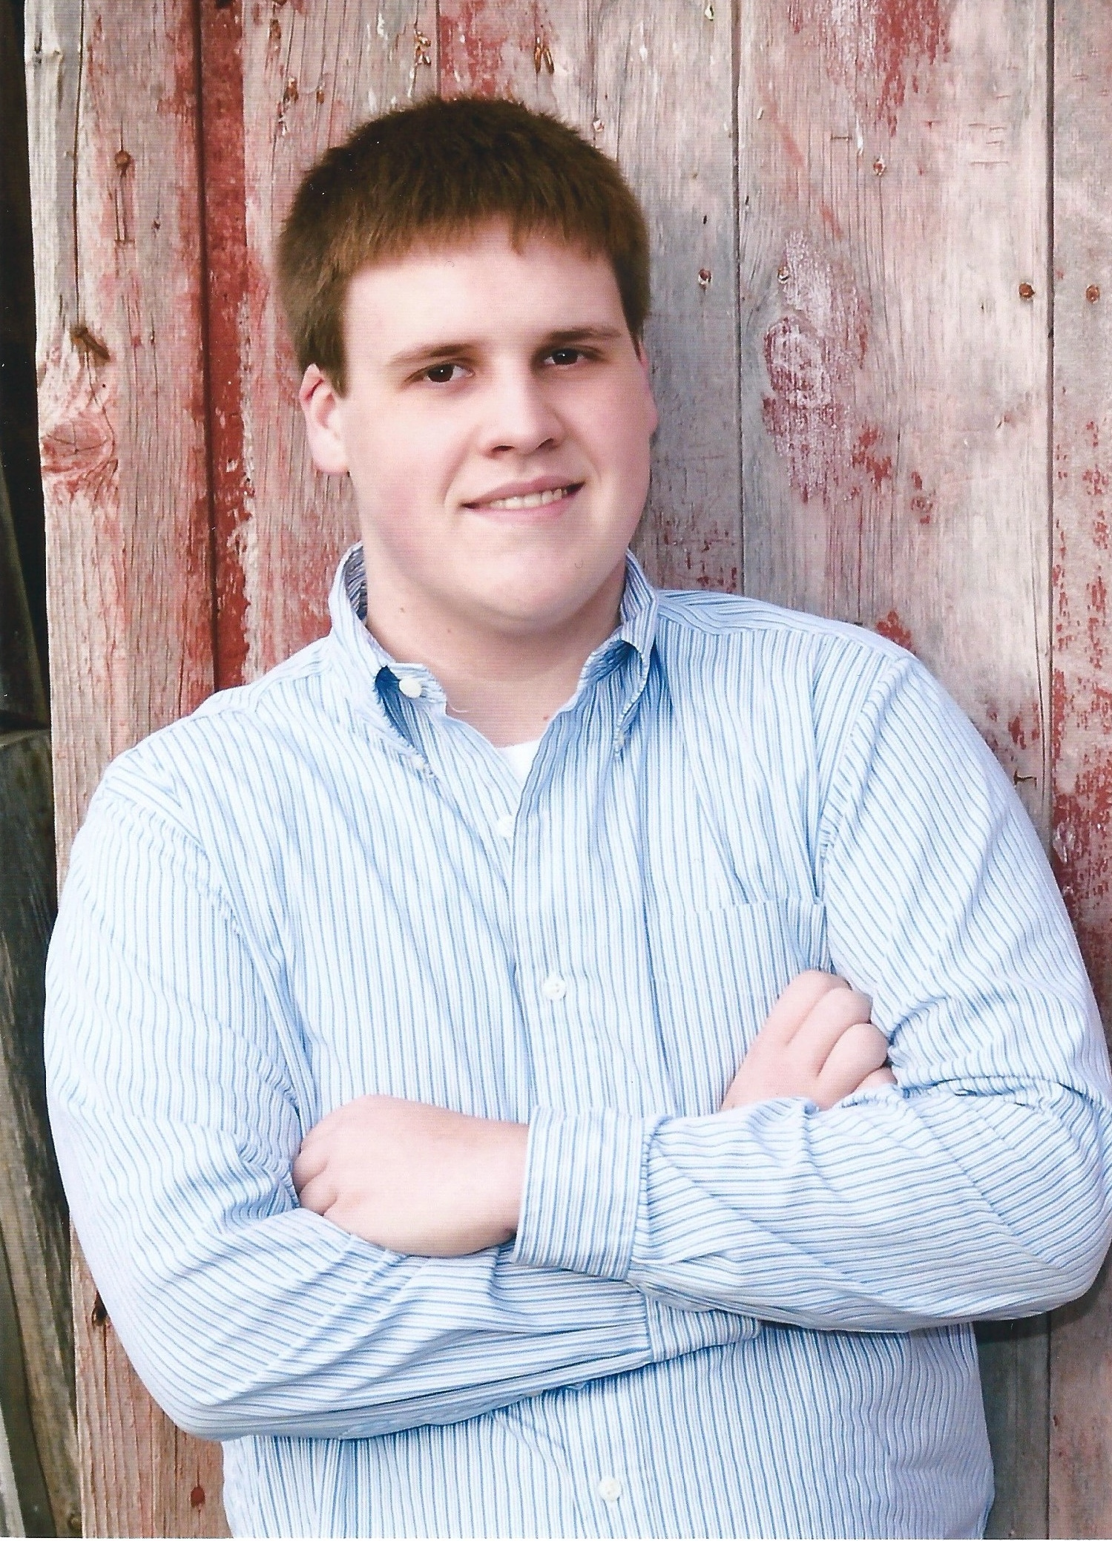
Markus Edwards
Markus is planning to attend UW Stevens Point to study Environmental Science.

Slide 13
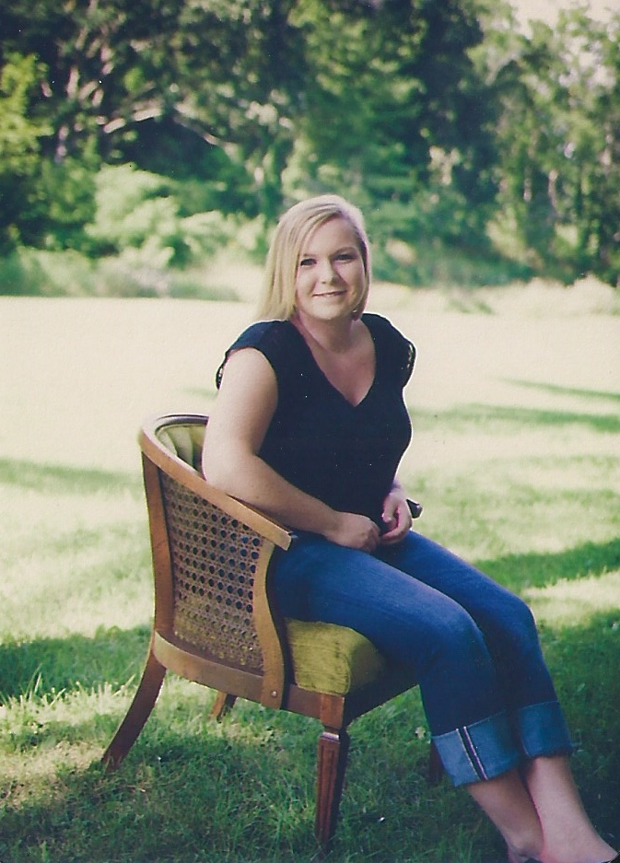
Abigail Marty
Abby will be attending UW Platteville in the fall

Slide 14

Other Graduates this year

Slide 15
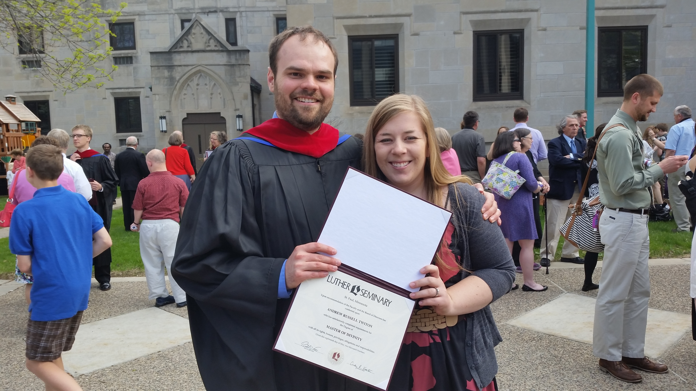
Andrew Twiton
Andy graduated on May 18th from Luther Seminary in St. Paul, MN
He is assigned to the South Central Synod of Wisconsin for his first call.

Slide 16
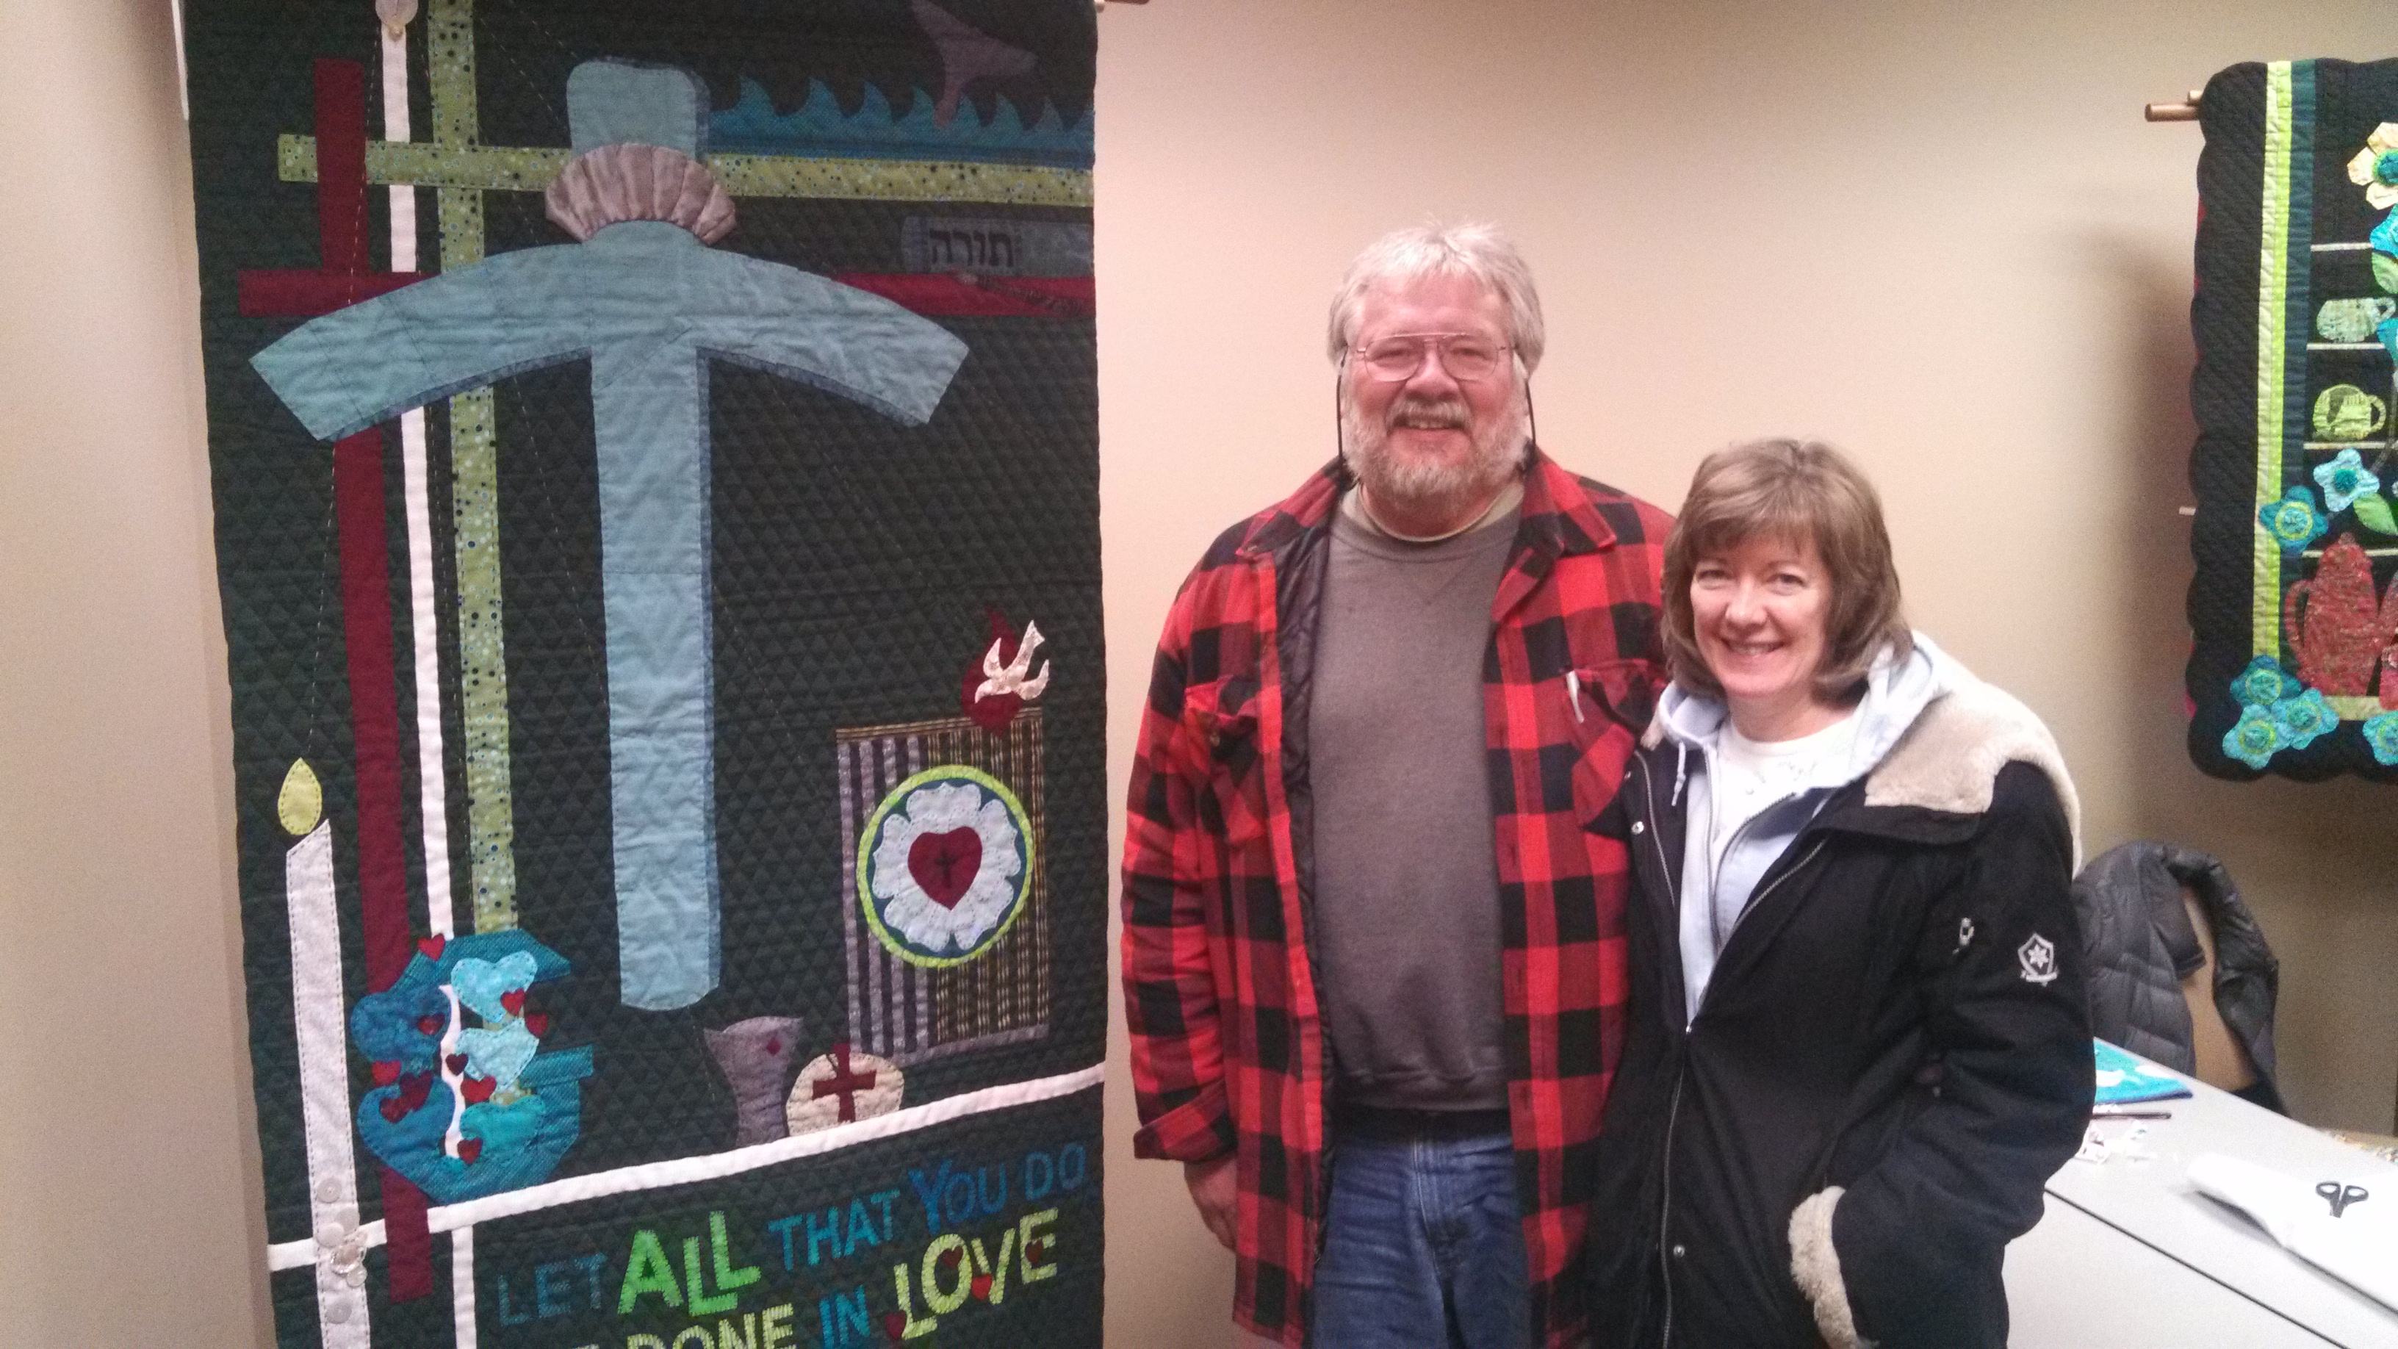
Donald Glanzer
Don graduated on May 18th from Wartburg Seminary in Dubuque, IA. He is assigned to the South Central Synod of Wisconsin for his first call.

Slide 17
God’s blessings and our prayers on the next steps for all of our graduates!

