Slide 1
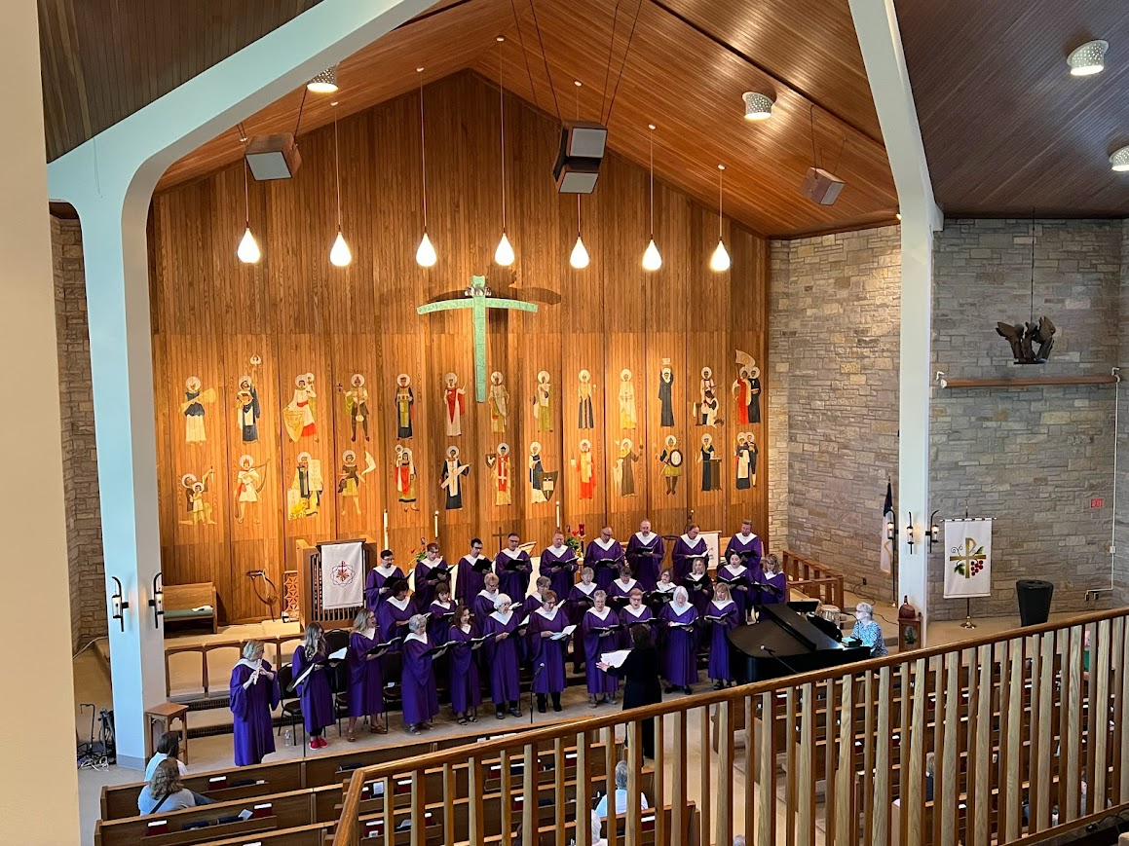
Welcome to worship at ELC
May 19, 2024

Slide 2
CONGREGATIONAL HYMN: HYMN #850 When in Our Music God Is Glorified

Slide 3
When in our music God is glorified,
and adoration leaves no room for pride,
it is as though the whole creation cried:
Alleluia, alleluia, alleluia!

Slide 4
How oft, in making music, we have found
a new dimension in the world of sound,
as worship moved us to a more profound
Alleluia, alleluia, alleluia!

Slide 5
So has the church, in liturgy and song,
in faith and love, through centuries of wrong,
borne witness to the truth in ev'ry tongue:
Alleluia, alleluia, alleluia!

Slide 6
And did not Jesus sing a psalm that night
when utmost evil strove against the light?
Then let us sing, for whom he won the fight:
Alleluia, alleluia, alleluia!

Slide 7
Let ev'ry instrument be tuned for praise;
let all rejoice who have a voice to raise;
and may God give us faith to sing always:
Alleluia, alleluia, alleluia!

Slide 9
HYMN
#838 Beautiful Savior

Slide 10
Beautiful Savior, King of creation,
Son of God and Son of Man!
Truly I'd love thee, truly I'd serve thee,
light of my soul, my joy, my crown.

Slide 11
Fair are the meadows,
fair are the woodlands,
robed in flow'rs of blooming spring;
Jesus is fairer,Jesus is purer,
he makes our sorrowing spirit sing.

Slide 12
Fair is the sunshine, fair is the moonlight,
bright the sparkling stars on high;
Jesus shines brighter, Jesus shines purer
than all the angels in the sky.
.

Slide 13
Beautiful Savior, Lord of the nations,
Son of God and Son of Man!
Glory and honor, praise, adoration,
now and forevermore be thine!

Slide 15
Apostles’ Creed (pg 105)
I believe in God, the Father almighty,
creator of heaven and earth.

Slide 16
Apostles’ Creed (pg 105)
I believe in Jesus Christ, God’s only Son, our Lord, who was conceived by the Holy Spirit, born of the virgin Mary, suffered under Pontius Pilate, was crucified, died, and was buried;

Slide 17
Apostles’ Creed (pg 105)
he descended to the dead. On the third day he rose again; he ascended into heaven, he is seated at the right hand of the Father, and he will come to judge the living and the dead.

Slide 18
Apostles’ Creed (pg 105)
I believe in the Holy Spirit, the holy catholic church, the communion of saints, the forgiveness of sins, the resurrection of the body, and the life everlasting. Amen.

Slide 20
CONGREGATIONAL HYMN
All Creatures of Our God and King

Slide 21
All creatures of our God and King,
Lift up your voice and with us sing,
"Alleluia! Alleluia!"

Slide 22
O burning sun with golden beam
and silver moon with softer gleam.
Alleluia, alleluia, alleluia, alleluia, alleluia!

Slide 23
O rushing wind and breezes soft,
O clouds that ride the winds aloft.
Alleluia! Alleluia!

Slide 24
O rising morn, in praise rejoice,
O lights of evening, find a voice.
Alleluia, alleluia, alleluia, alleluia, alleluia!

Slide 25
O flowing waters, pure and clear,
Make music for your Lord to hear.
Alleluia! Alleluia!

Slide 26
O fire so masterful and bright
Providing us with warmth and light.
Alleluia, alleluia, alleluia, alleluia, alleluia!

Slide 27
Dear mother earth, who day by day
Unfolds rich blessings on our way.
Alleluia! Alleluia!

Slide 28
The fruits and flow’rs that verdant grow,
Let them God’s praise abundant show.
Alleluia, alleluia, alleluia, alleluia, alleluia!

Slide 30
The Lord’s Prayer (pg 145)
Our Father, who art in heaven,
hallowed be thy name,
thy kingdom come,
thy will be done,
on earth as it is in heaven.

Slide 31
Give us this day our daily bread;
and forgive us our trespasses,
as we forgive those
who trespass against us;
and lead us not into temptation,
but deliver us from evil.

Slide 32
For thine is the kingdom,
and the power, and the glory,
forever and ever.
Amen.

Slide 33
+BENEDICTION
L: May the blessing of God our creator, the love of Jesus Christ our redeemer, and the presence of the Holy Spirit the comforter, surround you and sustain you until we gather again.
C: Amen.

